Slide 1

Breast Cancer Prediction and Detection through Machine and Deep Learning
David Kinney
Bellevue University
DSC 680 Applied Data Science
Professor Catherine Williams
June 5, 2021

Slide 2
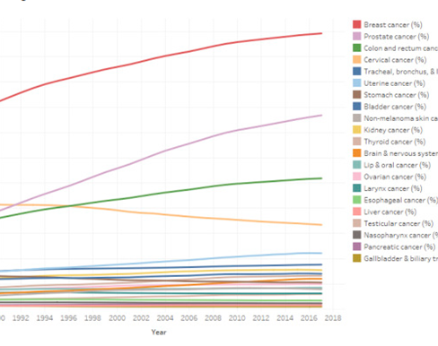
Cold Statistics…
About 1 in 8 U.S. women (about 13%) will develop invasive breast cancer over the course of her lifetime.
For women in the U.S., breast cancer death rates are higher than those for any other cancer, besides lung cancer.
As of January 2021, there are more than 3.8 million women with a history of breast cancer in the U.S. This includes women currently being treated and women who have finished treatment.
Breast cancer is the most commonly diagnosed cancer among American women. In 2021, it's estimated that about 30% of newly diagnosed cancers in women will be breast cancers.
Breast cancer became the most common cancer globally as of 2021, accounting for 12% of all new annual cancer cases worldwide, according to the World Health Organization.
Source: breastcancer.org
Source: https://www.kaggle.com/midouazerty/breast-cancer-images-classification

Slide 3
Motivation…
False negatives
In cancer screening, a negative result means no abnormality is present.
False-negative results occur when mammograms appear normal even though breast cancer is present.
Overall, screening mammograms miss about 20% of breast cancers that are present at the time of screening. [2]
While a false positive result may lead to undue stress and worry, the end result is no cancer.
False negatives are far more alarming, as the result in this case is a woman who believes she is cancer-free when she is not.
Hypothesis
Great strides have been made in both Machine and Deep Learning in various medical fields regarding the prediction and detection of certain diseases. One of these areas showing promising results is breast cancer; both prediction based on observable measurements and detection regarding whether a tumor is benign or malignant. In this presentation I hope to show two examples of models I trained that offer impressive results in this field.

Slide 4

Prediction via Machine Learning
Data: Breast Cancer Wisconsin (Diagnostic) dataset
Modeling
PyCaret: open source, low code Python library, providing wrappers around numerous machine learning frameworks such as scikit-learn, XGBoost, Microsoft LightGBM, spaCy and others.
Compare model baselines and create a best model
Leverage built-in function to tune hyperparameters
Plot results
Perform model prediction and evaluate results

Slide 5
Breast Cancer Wisconsin (Diagnostic) dataset
569 observations (357 benign, 212 malignant).
33 variables: ID, Diagnosis (M = Malignant, B = Benign)
The features for the Breast Cancer Wisconsin dataset are computed from a digitized image of a fine needle aspirate (FNA) of a breast mass. They describe characteristics of the cell nuclei present in the image. [3]
Ten real-valued features are computed for each cell nucleus.
The mean, standard error, and "worst" or largest (mean of the three largest values) of these features were computed for each image, resulting in 30 features.

Slide 6
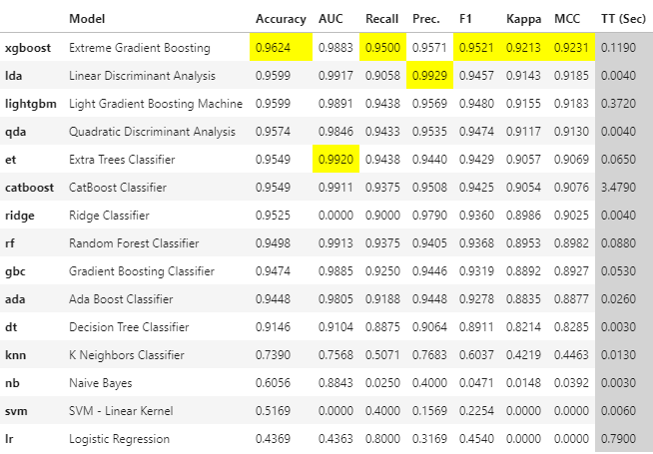

Functions…
setup - initializes the environment in pycaret and creates the transformation pipeline to prepare the data for modeling and deployment.
compare_models - trains all models in the model library and scores them using stratified cross validation for metric evaluation.
create_model - trains and evaluates a model using cross validation.
tune_model - automatically tunes the hyperparameters of a model using Random Grid Search on a pre-defined search space.
plot_model - used to analyze the performance across different aspects such as AUC, confusion_matrix, decision boundary etc. This function takes a trained model object and returns a plot based on the test / hold-out set.
predict_model - predict against the hold-out sample and evaluate the metrics to see if they are materially different than the CV results.

Slide 7
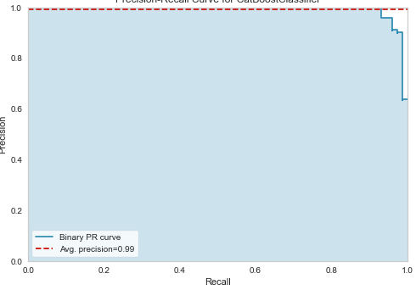
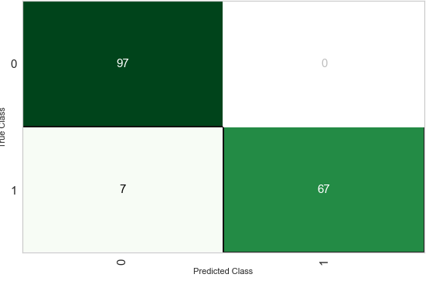
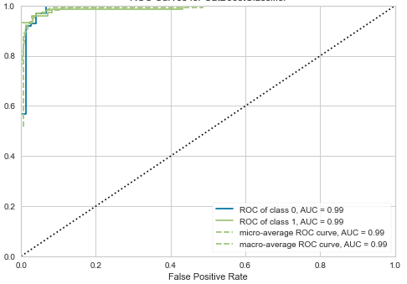
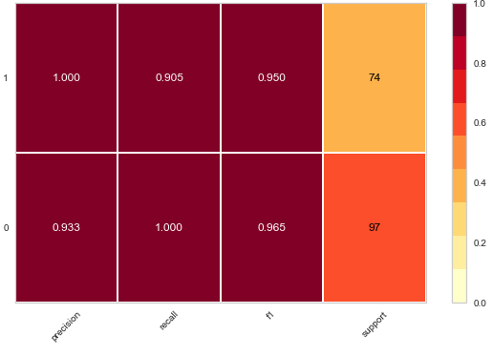
XGBoost Classifier: 96% Accuracy, F1 score of .95…

Slide 8
Prediction via Deep Learning
Data: Breast Histopathology Images
Modeling
fast.ai: a Deep Learning library with high-level components providing an abstracted layered API that leverages the PyTorch library.
Define a Convolutional Neural Network (CNN) object
Fine tune the model
Plot results
Perform model prediction and evaluate results

Slide 9
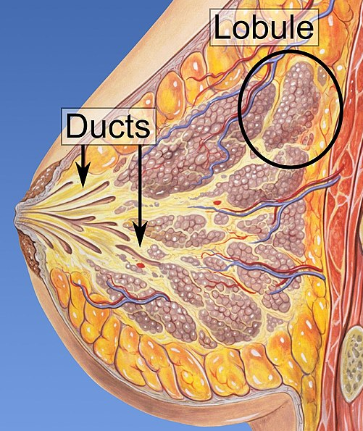
Abstract Breast Cancer & Invasive Ductal Carcinoma (IDC)
Abstract Breast cancer is a common cancer in women, and one of the major causes of death among women around the world.
IDC is the most widespread type of breast cancer with about 80% of all diagnosed cases.
The distinctive feature of the Breast Histopathology Images dataset as compared to similar ones is that it contains an equal number of specimens from each of three grades of IDC, which leads to approximately 50 specimens for each grade.
62 whole mount slide images of Breast Cancer (BCa) specimens scanned at 40x. From that, 277,524 patches of size 50 x 50 were extracted (198,738 IDC negative and 78,786 IDC positive).
Source: https://www.kaggle.com/midouazerty/breast-cancer-images-classification

Slide 10
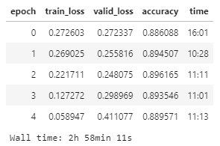
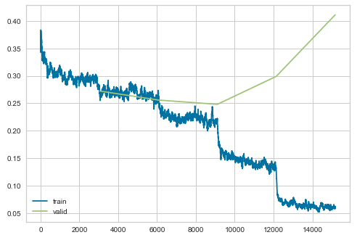
Create and train a ResNet34 CNN model

Slide 11
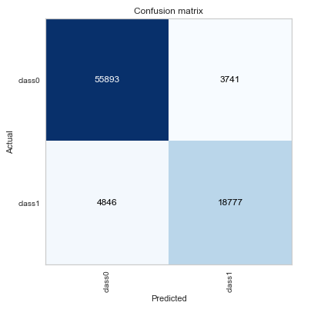
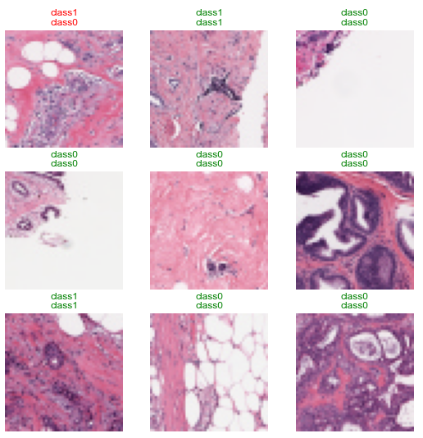
Results: 89% Accuracy, Negative Predictive Value of 92%...

Slide 12
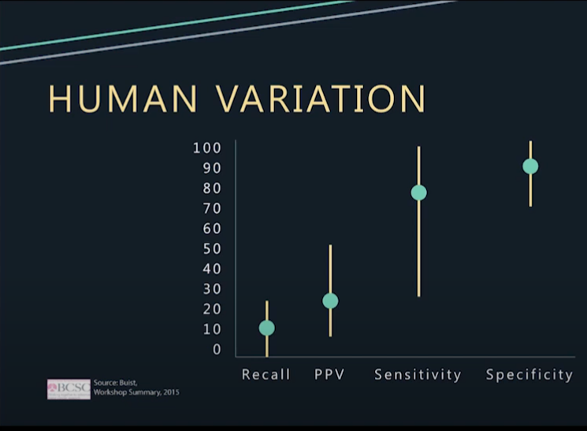
Model results compared to Humans
Sensitivity: 0.7948609406087288
Specificity: 0.937267330717376
Accuracy: 0.8968615251570438
PPV: 0.8338662403410605
NPV: 0.9202160061904213

Slide 13
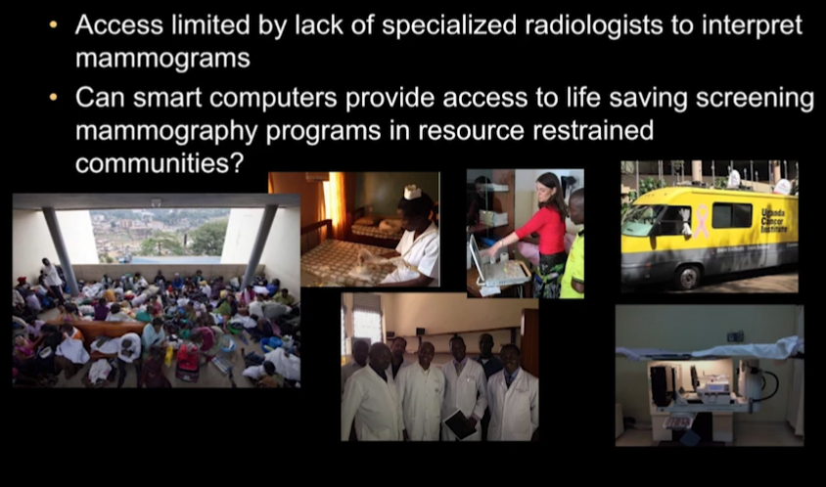
The problem and the solution…
Source: https://www.youtube.com/watch?v=sboje1e2EJE
Source: https://www.youtube.com/watch?v=sboje1e2EJE

Slide 14
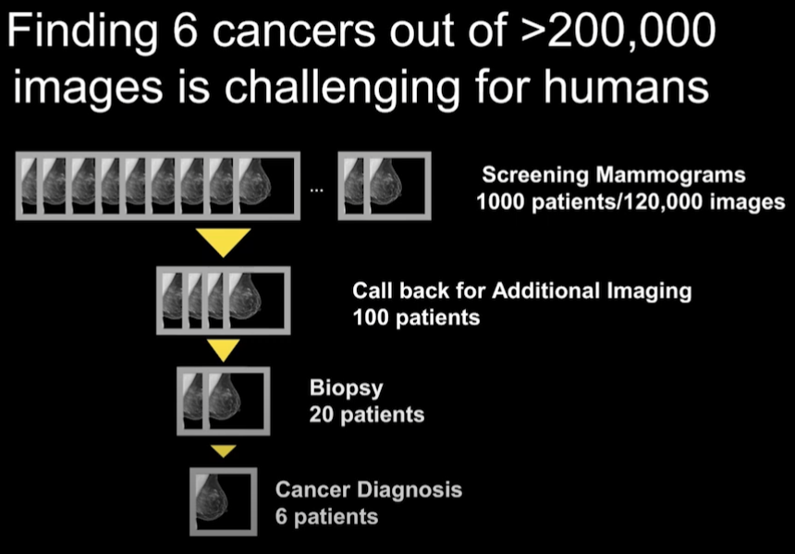
The challenge for human radiologists
Source: https://www.youtube.com/watch?v=sboje1e2EJE

Slide 15
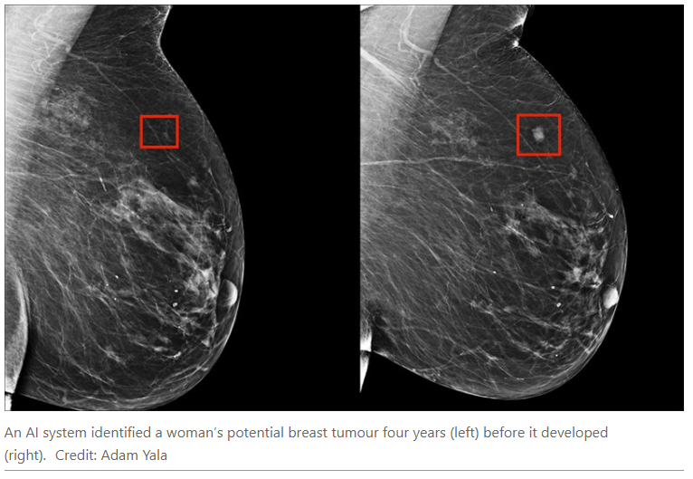
Artificial Intelligence…
FocalNet
Google
Dr. Constance Lehman

Slide 16

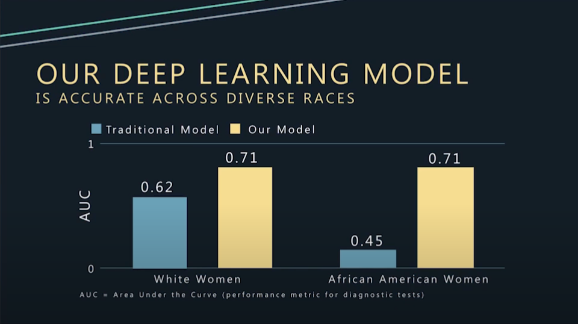
Dr. Constance Lehman, MD, PhD Director of Breast Imaging and Co-Director of the Avon Comprehensive Breast Evaluation Center at Massachusetts General Hospital
Source: https://www.youtube.com/watch?v=sboje1e2EJE

Slide 17

Thank you Bellevue University, and especially Professor Catherine Williams…

Slide 18
References
[1] Sammari S. (2021) Breast Cancer Image Classification
https://www.kaggle.com/midouazerty/breast-cancer-images-classification
[2] National Cancer Institute (n.d.) Breast Cancer – Mammograms
https://www.cancer.gov/types/breast/mammograms-fact-sheet
[3] UCI Machine Learning (2016) Breast Cancer Wisconsin (Diagnostic) Data Set
https://www.kaggle.com/uciml/breast-cancer-wisconsin-data
[4] Mooney, P. (2019) Breast Histopathology Images
https://www.kaggle.com/paultimothymooney/breast-histopathology-images

